Slide 1
MATERIAL UI for REACT
Mui package (Latest Version)

Slide 2
What is React
React is a JavaScript library for building user interfaces.
React is used to build single-page applications.
React allows us to create reusable UI components.

Slide 3
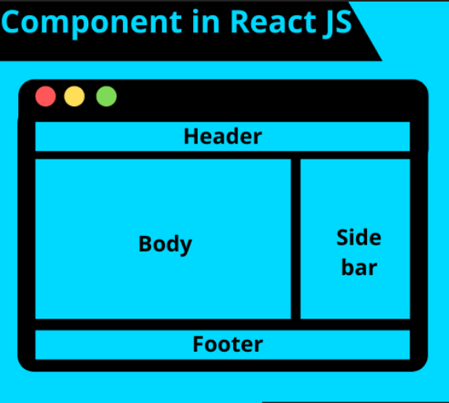
React Components
Components are separate pieces of code, where they can be separately designed, developed, maintained and tested.
To design and develop the components, we use JSX in react

Slide 4
React JSX
JSX is a syntax extension of regular JavaScript and is used to create React elements.
It makes easy for developers to create templates.
Instead of separating the markup and logic in separated files, React uses JSX in components
JSX Elements are created using same html logic, attributes are added same like html, javascript logic is added using {} expression

Slide 5
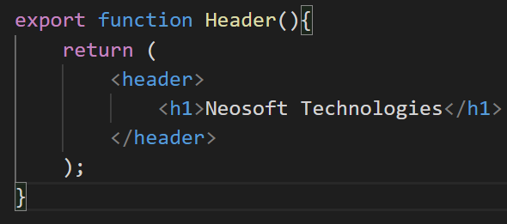
Header Component in React
header and h1 are JSX elements looks similar to html
Behind the seen, Javascript createElement function will be called

Slide 6
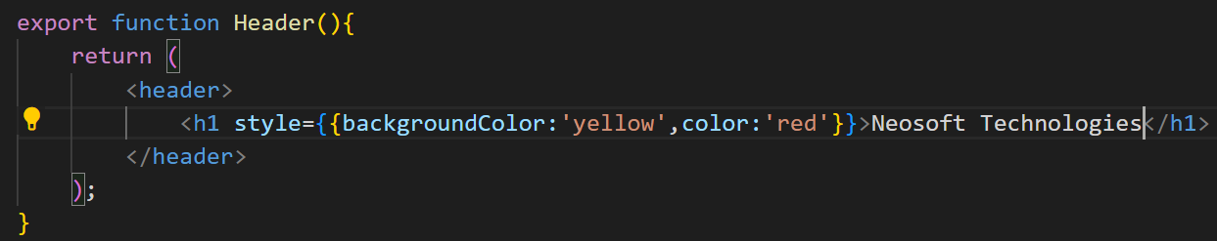
Styling React Components
Style attribute should be bind with JSX expression and Javascript object having CSS key value pairs

Slide 7
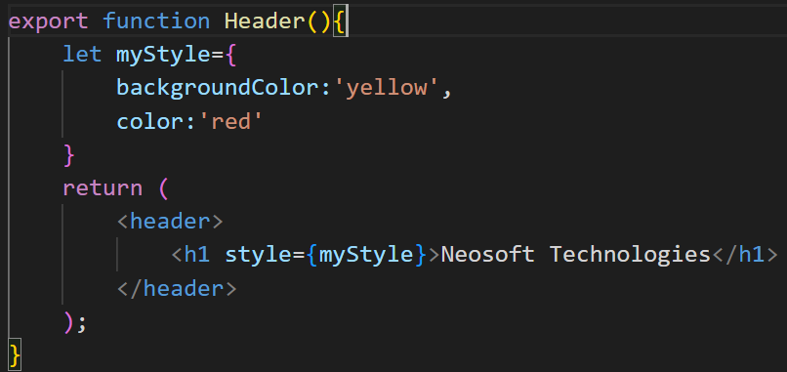
Styling React Components
Javascript object can be declared and used in JSX expressions as a value of style attribute

Slide 8
What is Material UI
React UI library
Using Material UI, we save a lot of time that we can spend on building features for your project or business.
Material UI provides us React components that implement Google’s material design.
Material design is developed by Google in 2014. It uses the grid-based layouts, responsive animations and transitions, padding, and depth effects such as shadows.
Material UI components work in isolation. They are self-contained, and will only inject the styles they need to display.
MUI: The React component library you always wanted

Slide 9
MUI Types
MUI Core
It includes a comprehensive collection of prebuilt components that are ready for use in production right out of the box, and features a suite of customization options that make it easy to implement your own custom design system on top of our components.
MUI X
MUI X is a collection of advanced React UI components for complex use cases. Use the native integration with Material UI or extend your design system.
Data Grid
Date and Time Pickers
Charts
Tree Views
Overview - Material UI (mui.com)

Slide 10
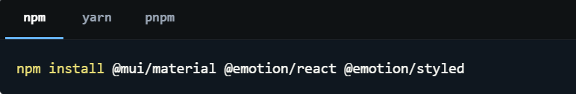
Install Material UI : 6.0.2
Default installation
Material UI uses Emotion as its default styling engine.
Emotion is a library designed for writing css styles with JavaScript.

Slide 11
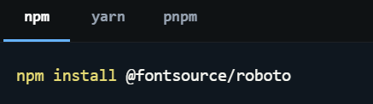
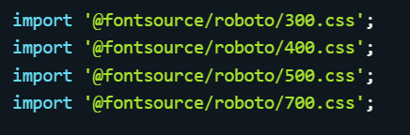
Install Material UI : 6.0.2
Roboto font
Material UI uses the Roboto font by default. Add it to your project via Fontsource, or with the Google Fonts CDN.
Then in index.js file add imports
Material UI's default typography configuration relies on the 300, 400, 500, and 700 font weights.
300 : light, 400 : regular… 700 : bold

Slide 12
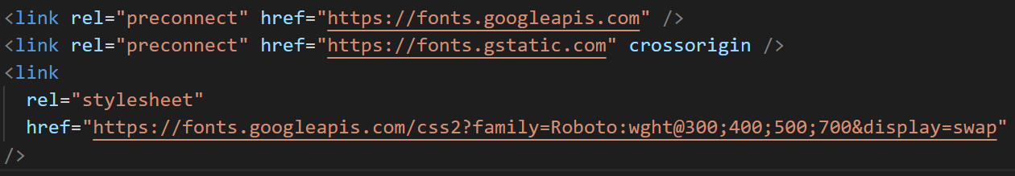

Install Material UI : 6.0.2
Roboto font
If we want to install Roboto through the Google Web Fonts CDN then
Icons
To use the font Icon component or the prebuilt SVG Material Icons, first install the Material Icons font

Slide 13
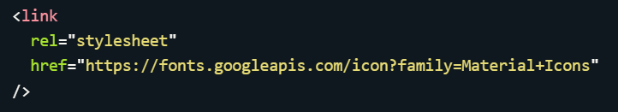
Install Material UI : 6.0.2
Icons
To install the Material Icons font using the Google Web Fonts CDN
We are done with installation
Installation Guide
Installation - Material UI (mui.com)

Slide 14
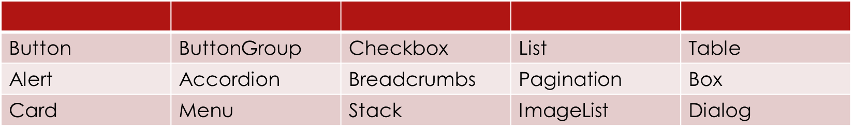
List of MUI components
All MUI components
Material UI components - Material UI (mui.com)

Slide 15
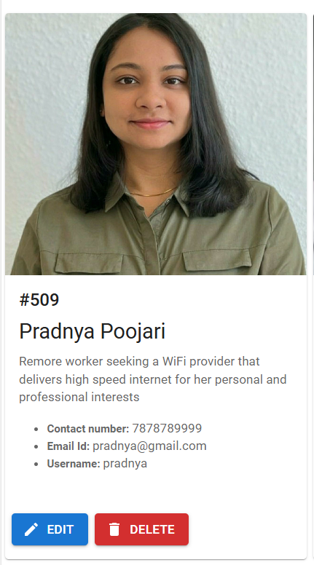
Example
Suppose we want to display customer details in Card.
We need MUI components for
Card
Button
Icon

Slide 16
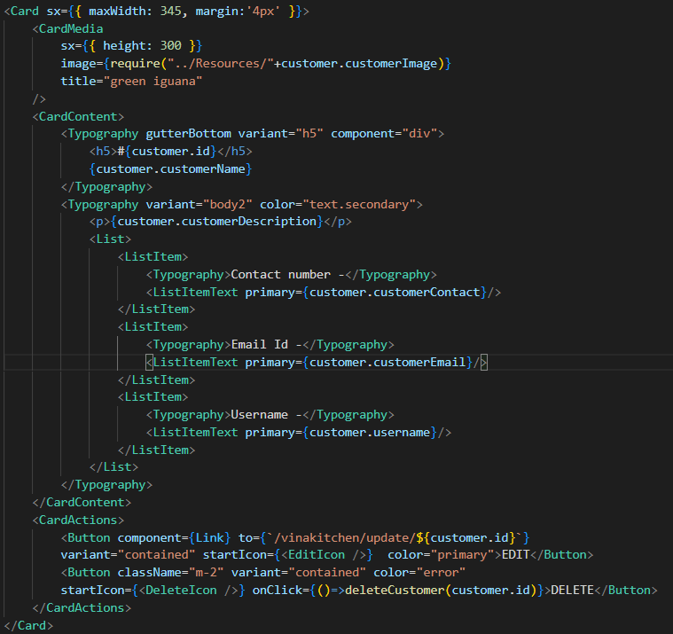
Card Example

Slide 17
MUI Card Component
Cards are surfaces that display content and actions on a single topic. The Material UI Card component includes several complementary utility components to handle various use cases:
Card: a surface-level container for grouping related components.
Card Content: the wrapper for the Card content.
Card Header: an optional wrapper for the Card header.
Card Media: an optional container for displaying background images and gradient layers behind the Card Content.
Card Actions: an optional wrapper that groups a set of buttons.
Card Action Area: an optional wrapper that allows users to interact with the specified area of the Card.

Slide 18
MUI Button Component
Buttons allow users to take actions, and make choices, with a single tap
Buttons communicate actions that users can take. They are typically placed throughout your UI, in places like:
Modal windows
Forms
Cards
Toolbars

Slide 19

MUI Icons
Google has created over 2,100 official Material icons, each in five different "themes" . For each SVG icon, we export the respective React component from the @mui/icons-material package.
Import icons using two options:
OR

Slide 20
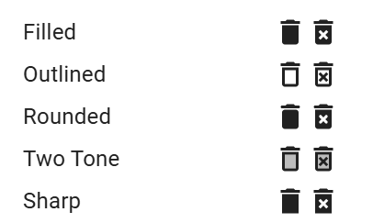
MUI Icons
Themes:
Filled theme (default) is exported as @mui/icons-material/Delete,
Outlined theme is exported as @mui/icons-material/DeleteOutlined,
Rounded theme is exported as @mui/icons-material/DeleteRounded,
Twotone theme is exported as @mui/icons-material/DeleteTwoTone,
Sharp theme is exported as @mui/icons-material/DeleteSharp.

Slide 21
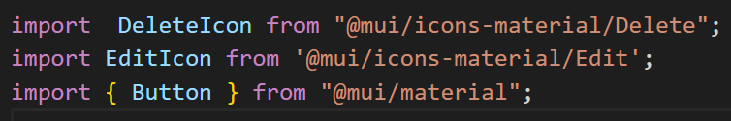
Example Implemented
React Button, DeleteIcon, EditIcon components
import following MUI components
Put following code to insert MUI components

Slide 22
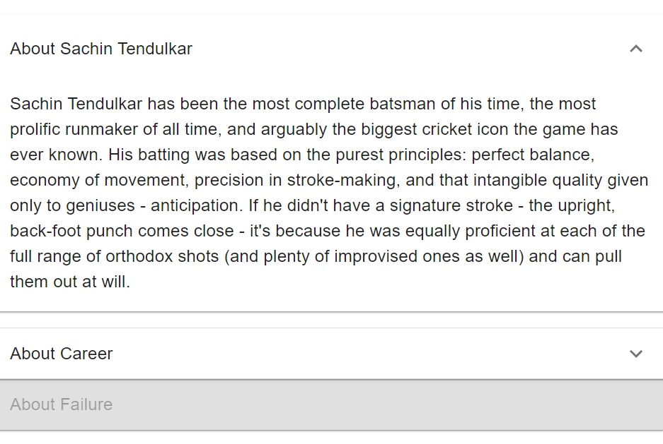
React Accordion
The accordion component allows the user to show and hide sections of related content on a page.
Can be used standalone, or be connected to a larger surface, such as a card.

Slide 23
Accordion Imports
import Accordion from '@mui/material/Accordion';
import AccordionSummary from '@mui/material/AccordionSummary';
import AccordionDetails from '@mui/material/AccordionDetails';
import Typography from '@mui/material/Typography';
import ExpandMoreIcon from '@mui/icons-material/ExpandMore';
More details about Accordion:
React Accordion component - Material UI (mui.com)

Slide 24
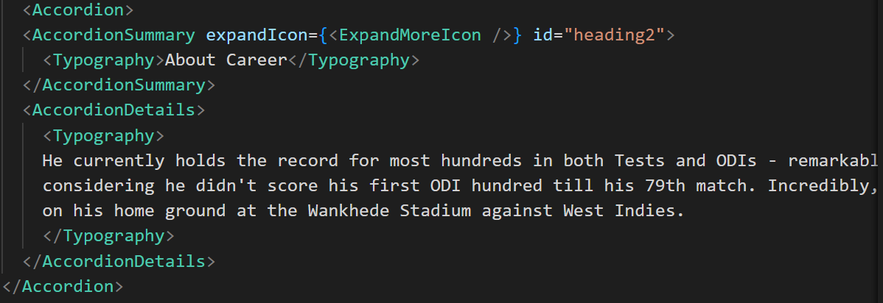
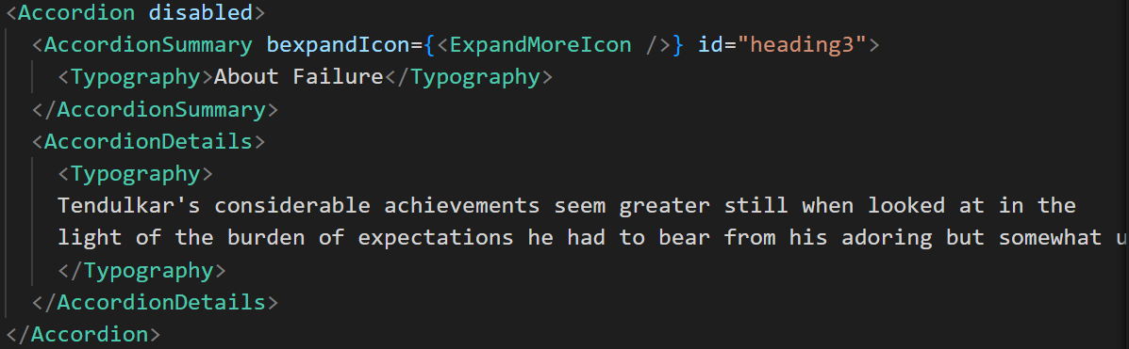
React Accordion

Slide 25
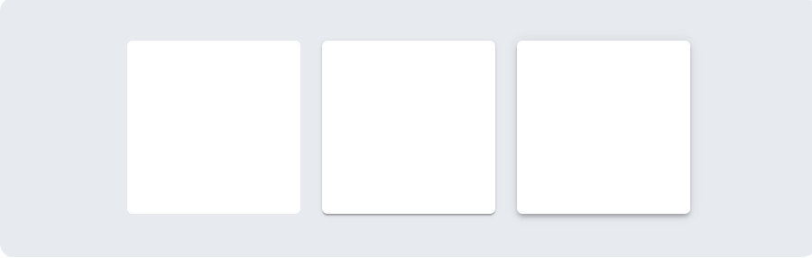
React Paper component
Paper represents the background of an application
resembles the flat, opaque texture of a sheet of paper
re-sized, shuffled, and bound together in multiple sheets.

Slide 26
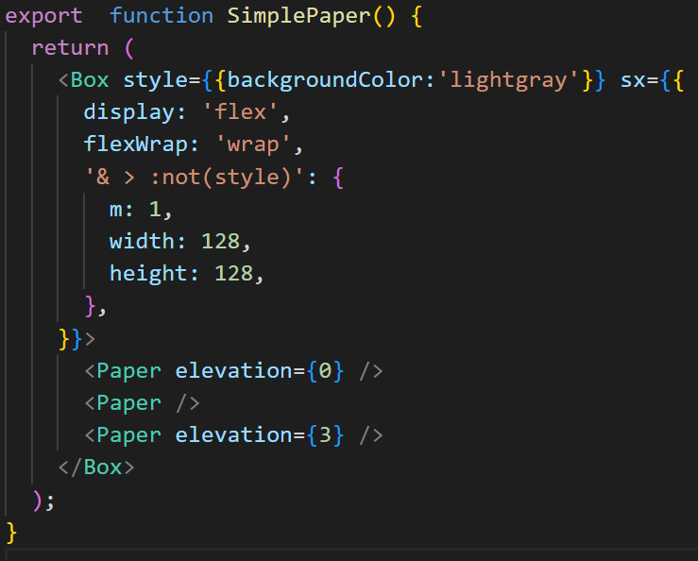
React Paper Component
elevation controls the size of the shadow applied to the surface.
In dark mode, raising the elevation also makes the surface lighter.

Slide 27
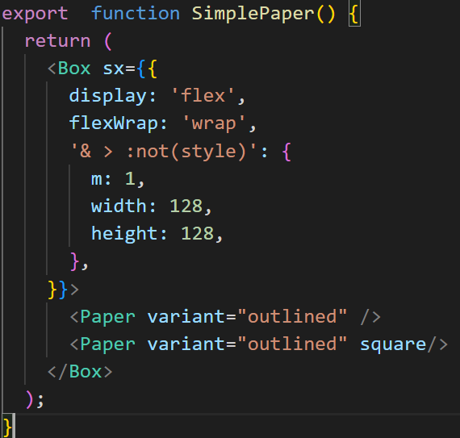
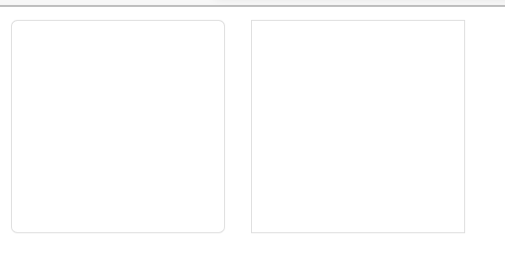
React Paper Component
If we need an outlined surface, use the variant prop.
More about Paper:
React Paper component - Material UI (mui.com)

Slide 28
More Examples on Material Components
React Pagination component - Material UI (mui.com)
React Grid component - Material UI (mui.com)
React Stack component - Material UI (mui.com)

Slide 29
THANK YOU

